Slide 1

C++ & DSA PLACEMENT COURSE
Khaiser Khanam

Slide 2

C++ INTRODUCTION 🔥 EVERYTHING YOU NEED TO KNOW TO GET STARTED!
1. What is Programming
2. What is C++
3. History and importance of C++
4. Compilation process

Slide 3


WHAT IS PROGRAMMING?

Slide 4




Slide 5




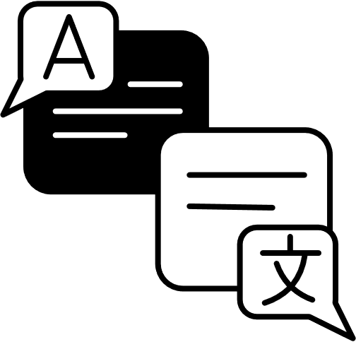
COMMUNICATE?
LANGUAGE

Slide 6



COMMUNICATE?
LANGUAGE

Slide 7
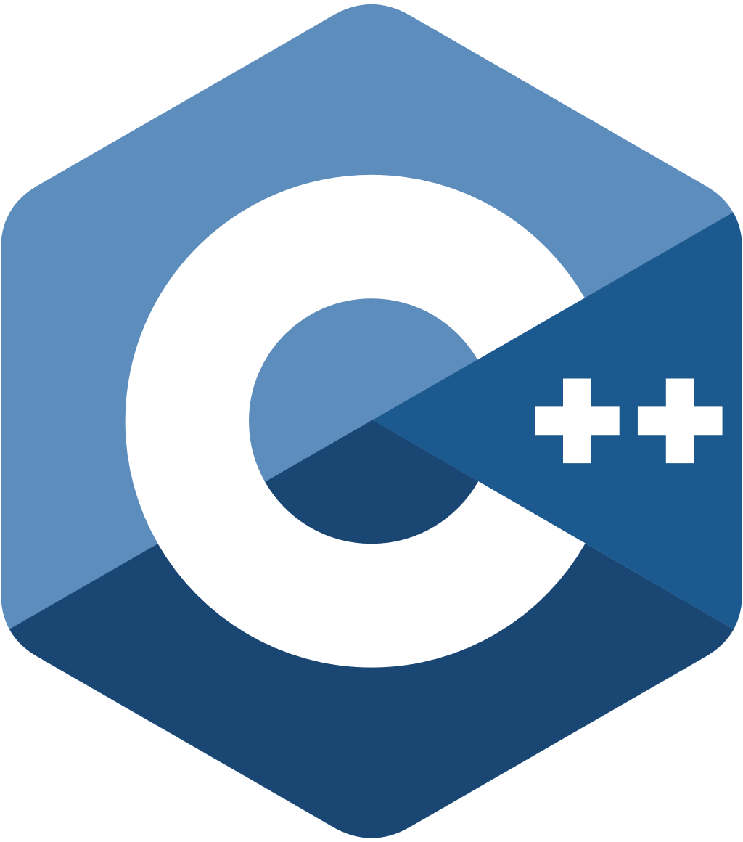




Slide 8


Slide 9


WHAT IS C++?

Slide 11
C++ SE KYA BANA HAI?
1.Windows ke kuch parts
2. Chrome ka rendering engine
3.PUBG wala Unreal Engine
4.Embedded devices
5. ATM software
6. Game development, etc..

Slide 12

KYUN SEEKHEIN C++ IN 2025
Logic

Slide 13

KYUN SEEKHEIN C++ IN 2025

Slide 14


STL (STANDARD TEMPLATE LIBRARY)

Slide 15
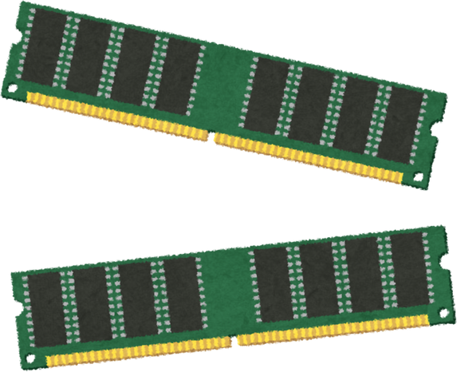

?
Low-level
High -level
Mid-level
OOP

Slide 16


HISTORY AND IMPORTANCE OF C++
1979
1983
Bjarne Stroustrup

Slide 17
HISTORY AND IMPORTANCE OF C++
Aaj kuch
toofani karte hain
Bjarne Stroustrup

Slide 18

46 years old
Old is Gold

Slide 19
COMPILATION PROCESS

Slide 20
COMPILATION PROCESS

Slide 21
COMPILATION PROCESS IN C++
1.Preprocessing
2.Compilation
3.Assembly
4.Linking

Slide 22
PREPROCESSING
( Safai aur Setting )

Slide 23
COMPILATION
( Code se Machine Code ka Translation )

Slide 24
ASSEMBLING
( Assembly Code se Machine Code)

Slide 25
LINKING
( Final Jod Tod )

Slide 26
1. Preprocessing – Makeup removal, face wash - Removes comments and adds libraries, defines constants.
2.Compilation – Language change - Converts C++ code to assembly code.
3.Assembling – Dress up in machine code - Converts assembly code to machine code (binary).
4.Linking – Shaadi karake final form bana do – .exe "-Links external libraries and functions, creates the final executable.

Slide 27
MCQ’S
1 . C++ kis language se develop hui thi?
2 . C++ ko hum kaunsi category ki programming language kehte hain?
a) Java
b) Python
c) C
d) Ruby
a) Low-level
b) High-level
c) Mid-level
d) Very High-level

Slide 28
MCQ’S
3 . C++ mein low-level features kaunse hain?
4 . C++ programming kis saal mein officially launch hui thi?
a) Memory ka direct access through pointers
b) Only object-oriented programming
c) Only web development
d) Machine Learning libraries
a) 1979
b) 1983
c) 1989
d) 1995

Slide 29
MCQ’S
5. Compilation process ka kaunsa step comments hataata hai aur libraries include karta hai?
6. Compilation ke baad C++ code kis form mein convert hota hai?
a) Assembling
b) Compilation
c) Preprocessing
d) Linking
a) JavaScript code
b) Assembly code
c) Python script
d) JSON file

Slide 30
MCQ’S
7 . Linking process ka kaam kya hota hai?
8. C++ kyun abhi bhi industry mein important hai?
a) Code ko beautify karna
b) Object files ko external libraries se connect karna
c) Code mein syntax errors dhoondhna
d) Data visualization karna
a) Sirf legacy code ke liye
b) Machine-level understanding aur FAANG interviews ke liye
c) Sirf beginners ke liye
d) Sirf games banane ke liye

